Slide 1

Gis mini-course
Day 5: Hacking QGIS with Python

Slide 2
Overview
The Python Console in Qgis
Packages/Modules
Working Directories
Loading Data
Leveraging the History Window

Slide 3
Benefits of python in qgis/arcgis
Python scripting is immensely useful even when using a GIS software
Python scripts keep a record of processing you have done
You never have to remember which button you pressed at step 5/75!
Make your workflows into legit methodologies
Those methodologies are transparent and shareable to collaborators and journal reviewers
Can take advantage of loops and iterators

Slide 4
Opening the python console
Select the Python console symbol in the Plugins toolbar
If you do not see this automatically, you may need to activate the Plugins toolbar by going to View > toolbars and checking the “Plugins toolbar” checkbox

Slide 5
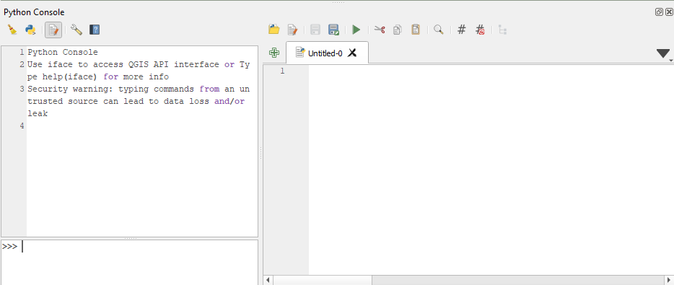
Opening a new script
Open a new script window by clicking the Show Editor button
A new script window will open to the right

Slide 6
Importing packages and functions into python
In R we use library() but in Python we use import or import as x
For example, we will want the os package to access directories and the pandas package to perform some calculations
import os
import pandas as pd
import qgis.core

Slide 7
Setting a working directory
Setting a working directory is a lot like R except you can place a “r” in front of a path to make it “relative” and you don’t need to change all the “\” to “/”
os.chdir(r"C:\Users\My folder")
os.getcwd()

Slide 8
Another option
You can also just set the path to your directory and use a “+” sign to extend a file path like (make sure to reverse the slashes like in R):
Which yields:
datapath = 'C:/Users/bowma/Desktop/GIS Mini-course Summer 2021/'
nyc_path = datapath + 'Day 1/data/'nybb.shp'
'C:/Users/bowma/Desktop/GIS Mini-course Summer 2021/Day 1/data/nybb.shp'

Slide 9
Loading a shapefile
Loading a shapefile only requires a file path, a name to enter into the TOC, and a provider (we will just use OGR here).
Your nyc shapefile should now be sitting in your TOC
vlayer = QgsVectorLayer(datapath + 'Day 1/data/nybb.shp', "nyc", "ogr")
QgsProject.instance().addMapLayer(vlayer)

Slide 10
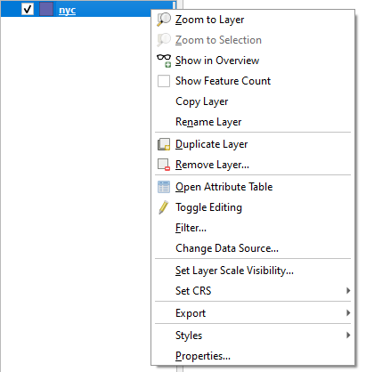
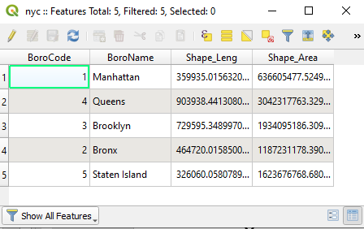
Checking Attribute table
The attribute table is GIS-speak for the data frame of a shapefile or spatial layer
You can avoid typing code by right-clicking the layer in your Table of Contents and selecting Open Attribute Table

Slide 11
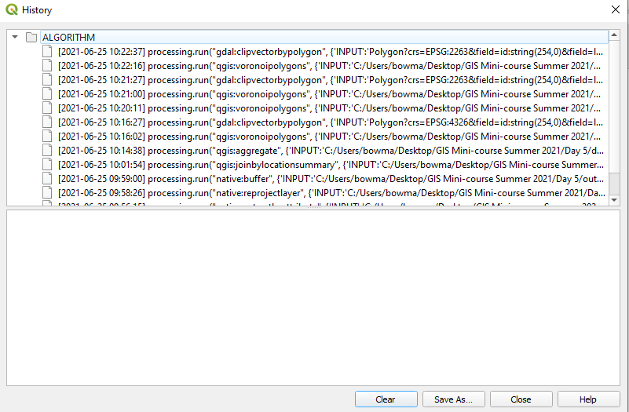
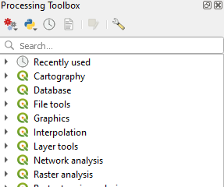
Leveraging the history function
You do not really need to memorize much code because you can always run tools, see if they worked correctly, then copy the python code from history
You can get here via the processing toolbox and selecting the clock button
All your previous tool runs (plus the ones that didn’t work right)

Slide 12

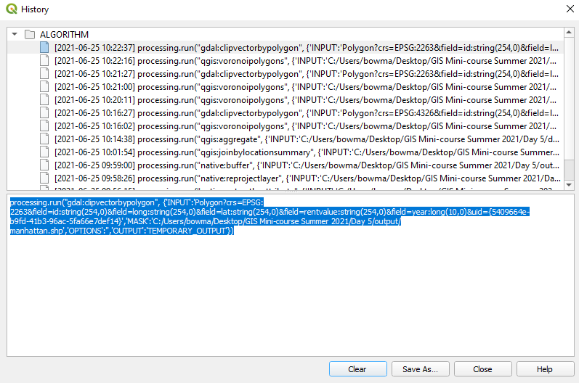
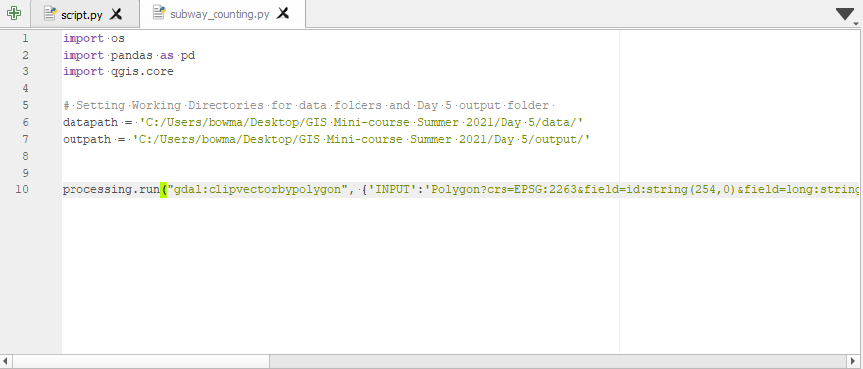
Copy-pasta
Then you can copy the python code and paste it into your script

Slide 13
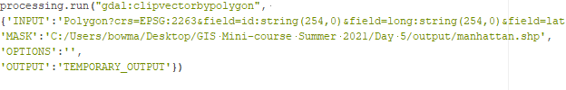
Keeping things organized
It will run fine the way it is, but we can spruce it up a bit and make it more reproducible and readable through some easy tricks
We can put each argument on its own line:
But it is still kind of incomprehensible, especially if you are using temporary layers!

Slide 14
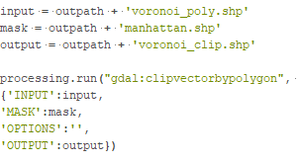
Use objects as arguments
You can clean up the code and customize it by assigning objects:
Much cleaner! And other users can customize their paths and parameters

Slide 15
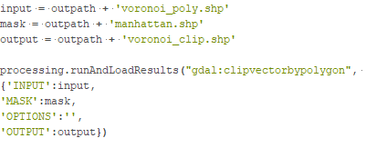
Run and load results
The code you copy from history will not automatically add things to your Table of Contents
So add “RunAndLoadResults” after processing.run:

